Slide 1

Artificial Intelligence based Real Time Deciphering of British Sign Language
The Very First Daisi Hackathon
By Aditya Singh

Slide 2
INTRODUCTION

Slide 3
INTRODUCTION
The act of exchanging information with one another is called communication.
The aim of the project is to provide a solution so the mute/deaf people can communicate with everyone else.
People with such speech impairment use gestures and hand signs to communicate.
The project provides a simple and accurate solution for Real Time Detection of British Sign Language .

Slide 4
Literature Review

Slide 5
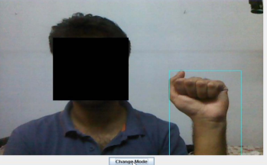
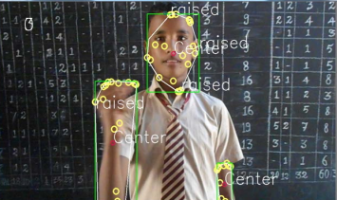
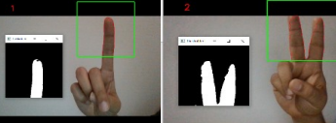
LITERATURE REVIEW
Sign Language Recognition and Speech to Sign language conversion system
This system extracts signs from video sequences in dynamic backgrounds using skin colour segmentation. Speech recognition is done by Sphinx module.
Real-Time Recognition of Indian Sign Language
This paper presents prediction of real time Indian Sign language gestures using fuzzy c-means clustering algorithm.
ML Based Sign Language Recognition System
The proposed system detects predefined signs by the user with the help of convex hull for feature extraction and KNN for classification.

Slide 6
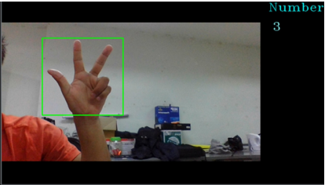
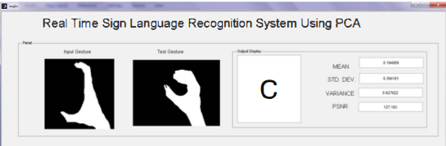
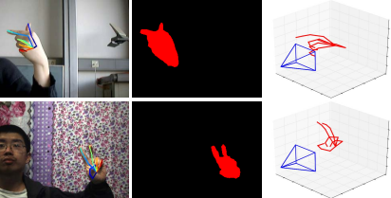
LITERATURE REVIEW
Real-time Bhutanese Sign Language digits recognition system using Convolutional Neural Network
The proposed system used 6 layers of CNN for feature extraction for predicting digits real time in Dzongkha and English text of Bhutanese Sign Language.
Real Time Sign Language Recognition using PCA
This paper presents recognition of Indian Sign language using skin colour segmentation and PCA algorithm. Eigen values and vectors for feature extraction.
Estimate 3D Hand Pose from Single RGB Images
In this paper the authors propose a self created system for detection of 3D hand poses. HandSegNet localizes hand mask by segmentation. PoseNet localizes kepoints on score maps. PosePrior estimates the likely 3D structure on the score maps.

Slide 7
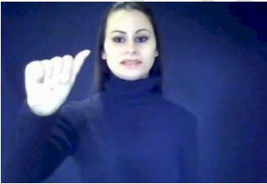
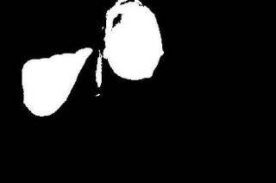
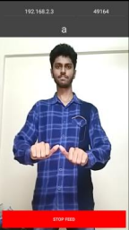
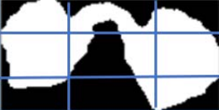
LITERATURE REVIEW
Hand Gesture Recognition based on Digital Image Processing using MATLAB
This system recognizes gestures of American Sign Language including the alphabet and a subset of its words. Template Matching technique is the primary hand gesture sign detection method used in this system.
Real-time Indian Sign Language (ISL) Recognition
In this paper the gestures and hand poses from Indian Sign language are predicted using Grid-Based feature extraction. Hand poses are classified using KNN algorithm. Hidden Markov Model is used for observation of gestures and hand poses in motion.

Slide 8
RESEARCH GAP
The systems proposed in recent literature use computationally heavy architectures that are not fit for deployment on an embedded system.
Most of the existing systems have not been deployed on hardware.
The models using KNN architecture have a lower accuracy. ( < 80% )
The need to process huge amounts of dataset.
In cases of occlusion the systems would not predict the signs.

Slide 9
METHODOLOGY

Slide 10
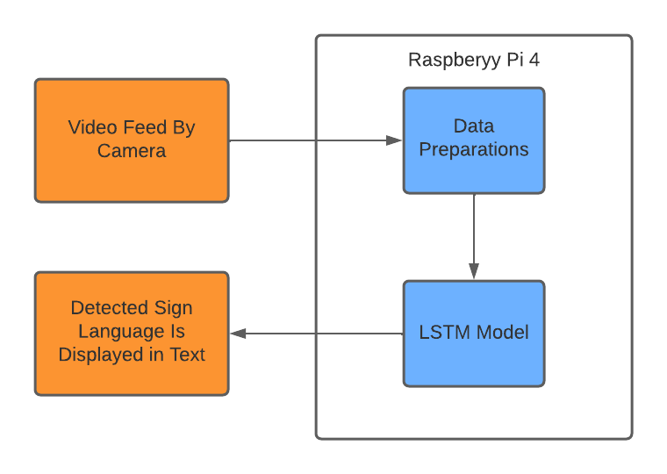
INTRODUCTION TO THE MODEL
Real time British Sign language.
MediaPipe framework for feature extraction.
One LSTM and One Dense layer used for real time detection.
The output is displayed in text.
Signs-“Hello” , “Thank You”, “Sorry”, “Help”, “Home”.
Block Diagram of the Model

Slide 11
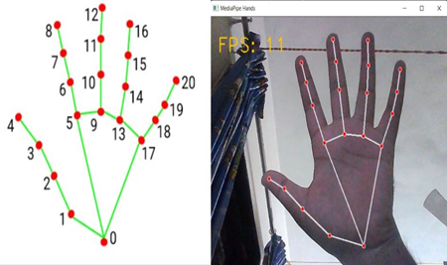
KEYPOINT EXTRACTION
Hand Landmark detection is the necessary criteria in the real time detection of BSL in the project.
For the same MediaPipe framework is used as it provides predefined 21 landmarks on each hand.
Key point extraction is done on all the frames.
These frames are the used for training the model and in real time detection.
Fig. A 21 MediaPipe Hand landmarks

Slide 12
Keypoint (Index) | Description | Keypoint (Index) | Description
0 | WRIST | 11 | Middle finger distal interphalangeal joint
1 | Thumb carpometacarpal joint | 12 | Middle finger tip
2 | Thumb metacarpophalangeal joint | 13 | Ring finger metacarpophalangeal joint
3 | Thumb interphalangeal joint | 14 | Ring finger proximal interphalangeal joint
4 | Thumb tip | 15 | Ring finger distal interphalangeal joint
5 | Index finger metacarpophalangeal joint | 16 | Ring finger tip
6 | Index finger proximal interphalangeal joint | 17 | Little finger metacarpophalangeal joint
7 | Index finger distal interphalangeal joint | 18 | Little finger proximal interphalangeal joint
8 | Index finger tip | 19 | Little finger distal interphalangeal joint
9 | Middle finger metacarpophalangeal joint | 20 | Little finger tip
10 | Middle finger proximal interphalangeal joint
Fig. B 21 Defined Hand landmarks

Slide 13
DATA PRE-PROCESSING
All the frames were converted from BGR to RGB.
The frames are stored in the form of a matrix labelling for all the five signs.

Slide 14
CREATING DATASET
Camera-5 MP
Recognition of key points on the obtained frames is done with the help of MediaPipe holistic.
The frames are stored in separate folders in the form of a NumPy file.
Each folder consists of 900 different frames.
The dataset consists of a total 4500 different frames.

Slide 15
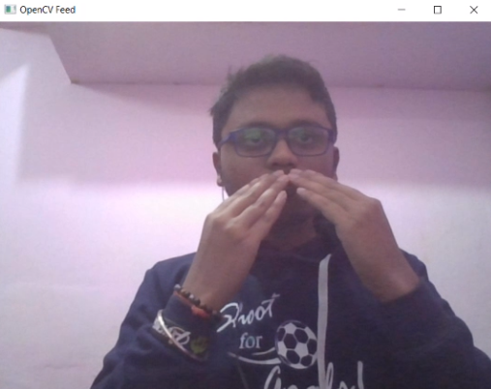
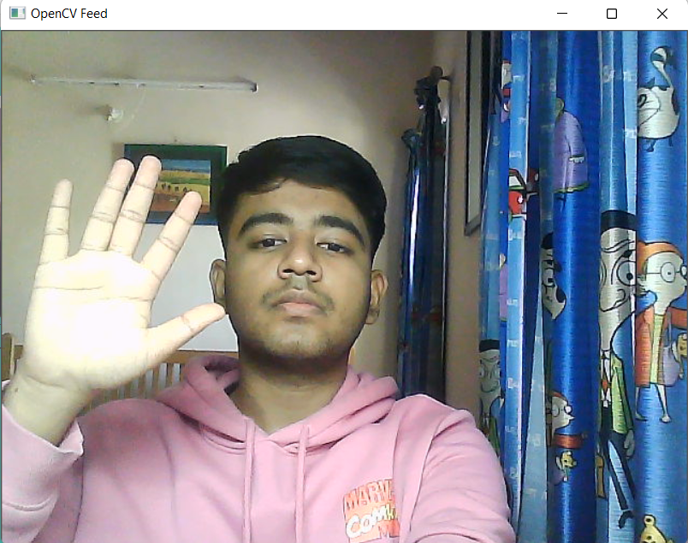
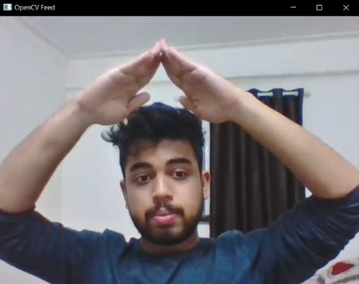
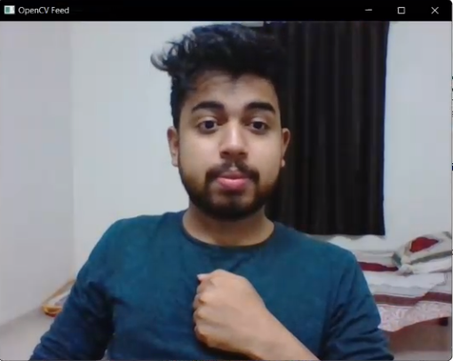
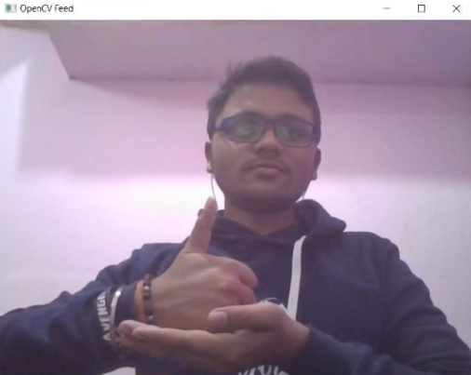
SAMPLE FROM DATASET
THANK YOU
HELLO
HOME
SORRY
HELP

Slide 16
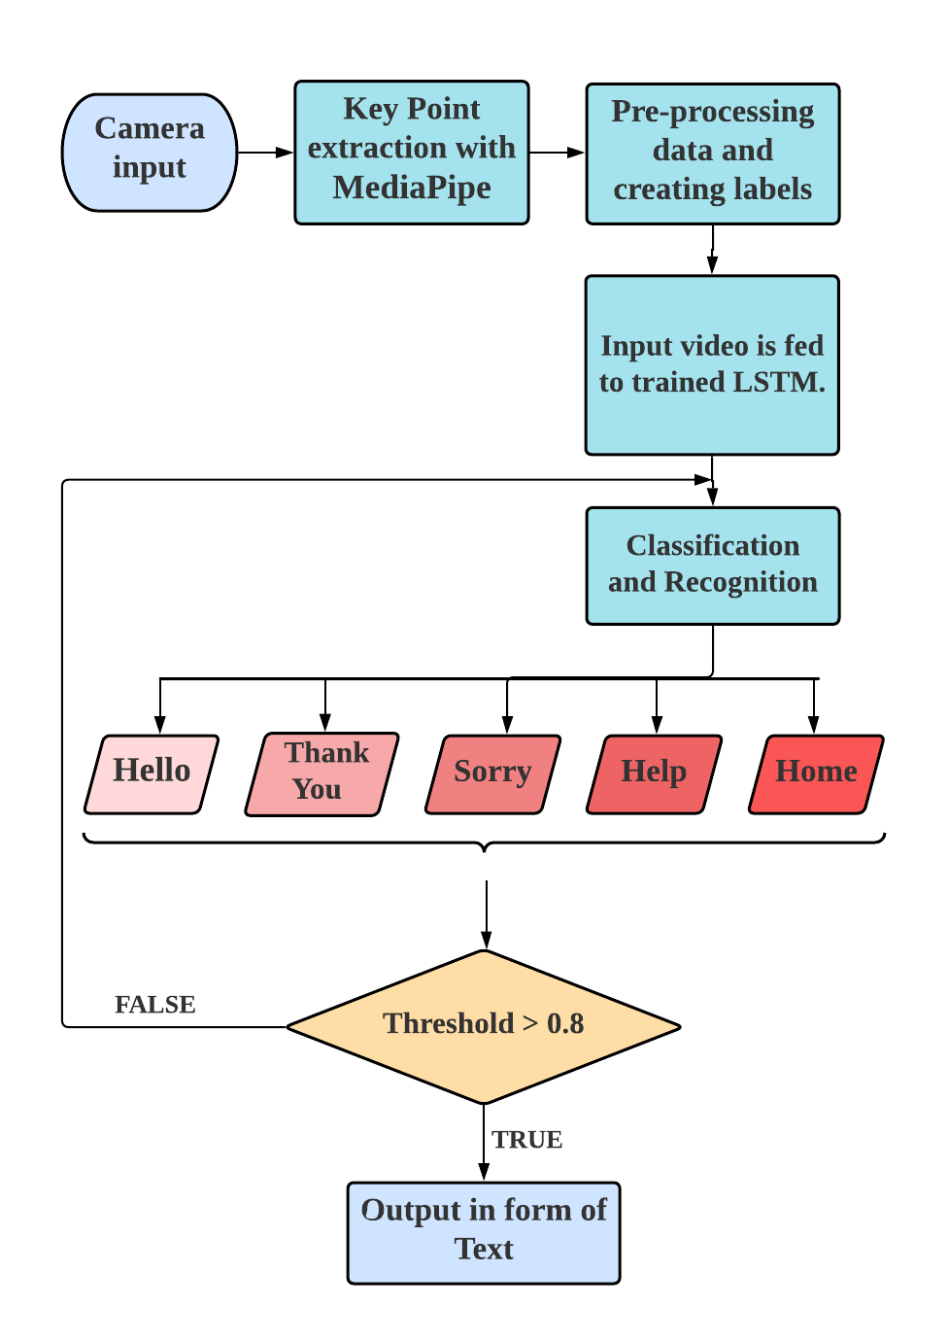
CLASSIFICATION & DETECTION
The model uses (Sequential model from TensorFlow) with “relu” activation function.
The LSTM and Dense layer were finalized based on difference between the categorical loss and validation loss of the model.
Considering the lowest loss difference, the model uses one LSTM layer with 32 units and one dense neural network layer.
The model is trained on 50 epochs.
The model was successfully trained with a training accuracy of 96 %.

Slide 17
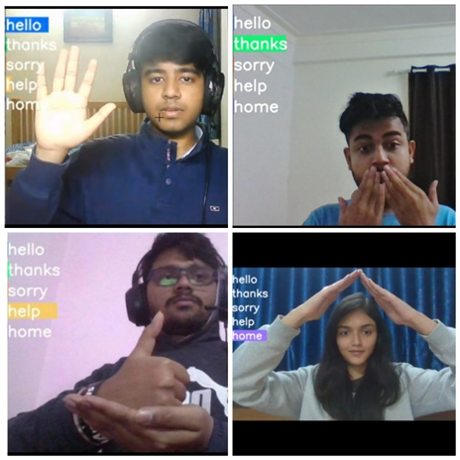
CLASSIFICATION & DETECTION
Fig. C Sign gestures with confidence bar

Slide 18
RESULTS

Slide 19
PERFORMANCE METRICS
The key classification metrics:
Accuracy, Recall, Precision, and F1- Score
PARAMETERS | VALUE
Precision | 0.9468
Recall | 0.9364
F1 score | 0.9349
Accuracy | 0.891
Precision presents the quality of positive predictions.
Recall returns the number of relevant results.
F1 score indicates the quality of both precision and recall.
Accuracy means how well the models predict all of the labels correctly.

Slide 20
NOVELTY & LIMITATIONS
The dataset can be manually prepared by the users for customization.
It is a lightweight LSTM architecture which results fast in BSL detection in Real Time.
The system is implemented on raspberry pi 4 with minimal cost.
The limitation of the system is that its performance reduces when the movement of hands is very fast.
Currently only five sign language are recognized by the system

Slide 21
COMPARISON WITH OTHER SIMILAR SYSTEMS

Slide 22
Real-Time Recognition of Indian Sign Language | Sign Language Recognition | Artificial Intelligence based Real Time Deciphering of British Sign Language
Accuracy is 75%. | Accuracy is 85%. | Accuracy is 89%.
High Computational time | Quite sensitive to noisy data. | Sensitive to fast motion of hands.
Fuzzy C- means Clustering is used. | Classifiers uses back propagation algorithm to classify images. | Long Short-Term Memory is used for training the model along with a Dense layer.
In data pre-processing Color Objects extracted from the image by converting the images from BGR to HSV. | The data pre-processing images are converted from BGR to RGB pixels. | In data pre-processing the images are converted from BGR to RGB.
Table. A Comparing Three similar systems.

Slide 23
CONCLUSION
Model used LSTM and Dense layer techniques to predict signs.
The more easily distinguishable signs were “Hello"," Thank You” & ” Home” as their signs mapping overlap.
The model showed confusion in detection of “Help” & “Sorry” as their signs mapping overlap.
The system is fast and up to 89 % accurate in detection of the British Sign Language.

Slide 24
REFERENCES

Slide 25
REFERENCES
[1] “World Health Organization: International Ear Care Day”, March 3, 2014. Accessed on: Oct. 15, 2021. [Online].Available:https://www.who.int/pbd/deafness/IECD_Report_2014.pdf
[2] A. Kumar, K. Thankachan and M. M. Dominic, "Sign language recognition," 2016 3rd International Conference on Recent Advances in Information Technology (RAIT), 2016, pp. 422-428, doi: 10.1109/RAIT.2016.7507939.
[3] H. Muthu Mariappan and V. Gomathi, "Real-Time Recognition of Indian Sign Language," 2019 International Conference on Computational Intelligence in Data Science (ICCIDS), 2019, pp. 1-6, doi: 10.1109/ICCIDS.2019.8862125.
[4] K. Shenoy, T. Dastane, V. Rao and D. Vyavaharkar, "Real-time Indian Sign Language (ISL) Recognition," 2018 9th International Conference on Computing, Communication and Networking Technologies (ICCCNT), 2018, pp. 1-9, doi: 10.1109/ICCCNT.2018.8493808.
[5] K. Amrutha and P. Prabu, "ML Based Sign Language Recognition System," 2021 International Conference on Innovative Trends in Information Technology (ICITIIT), 2021, pp. 1-6, doi: 10.1109/ICITIIT51526.2021.9399594.

Slide 26
REFERENCES
[6] T. Karayılan and Ö. Kılıç, "Sign language recognition," 2017 International Conference on Computer Science and Engineering (UBMK), 2017, pp. 1122-1126, doi: 10.1109/UBMK.2017.8093509.
[7] Priyanka Mekala , Ying Gao , Jeffrey Fan , Asad Davari, “ Real-time Sign Language Recognition based on Neural Network Architecture” DOI: 10.1109/SSST.2011.5753805
[8] Karma Wangchuk, Panomkhawn Riyamongkol, Rattapoom Waranusast, “Real-time Bhutanese Sign Language digits recognition system using Convolutional Neural Network” ICT Express, Volume 7, Issue 2,2021, ISSN 2405-9595 doi:/10.1016/j.icte.2020.08.002.
[9] Okan Kpkl, Ahmet Gunduz, Neslihan Kose, Gerhard Rigoll, Real-time Hand Gesture Detection and Classification using Convolutional Neural Networks, paper accepted to IEEE International Conference on Automatic Face and Gesture Recognition (FG 2019).
[10]S. N. Sawant and M. S. Kumbhar, "Real time Sign Language Recognition using PCA," 2014 IEEE International Conference on Advanced Communications, Control and Computing Technologies, 2014, pp. 1412-1415, doi: 10.1109/ICACCCT.2014.7019333.

Slide 27
Thank You! We extend our sincere gratitude to Daisi and Hacker earth for giving me this amazing opportunity.

